Slide 1
snapdragon
T.Dharani - 1818113
K.Sowndarya - 1818153

Slide 2
Ex:07 Chat client and Server
Aim:
To write a python program to implement
chat with Client and Server.

Slide 3
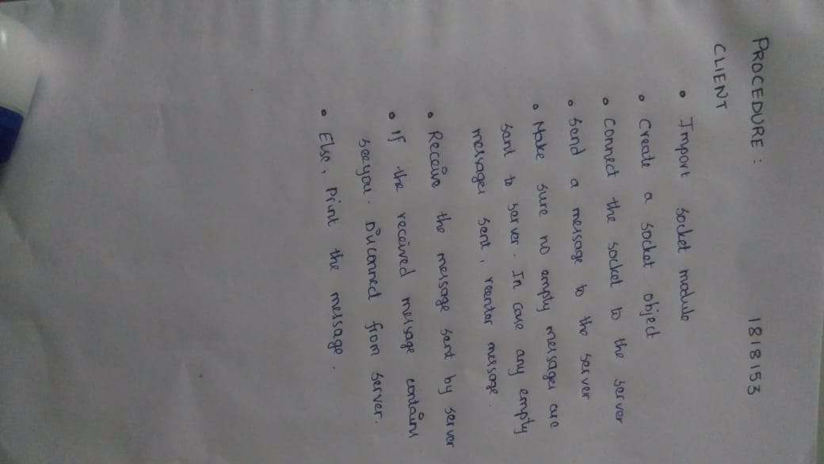

Slide 4
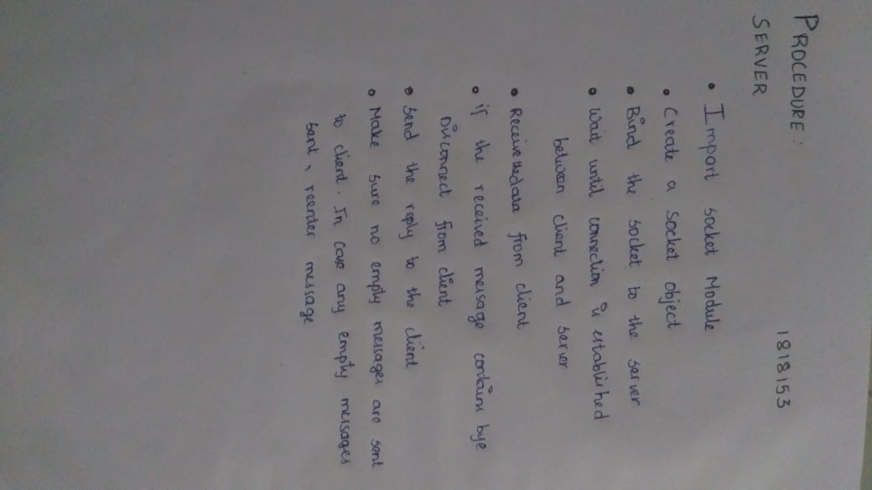

Slide 5
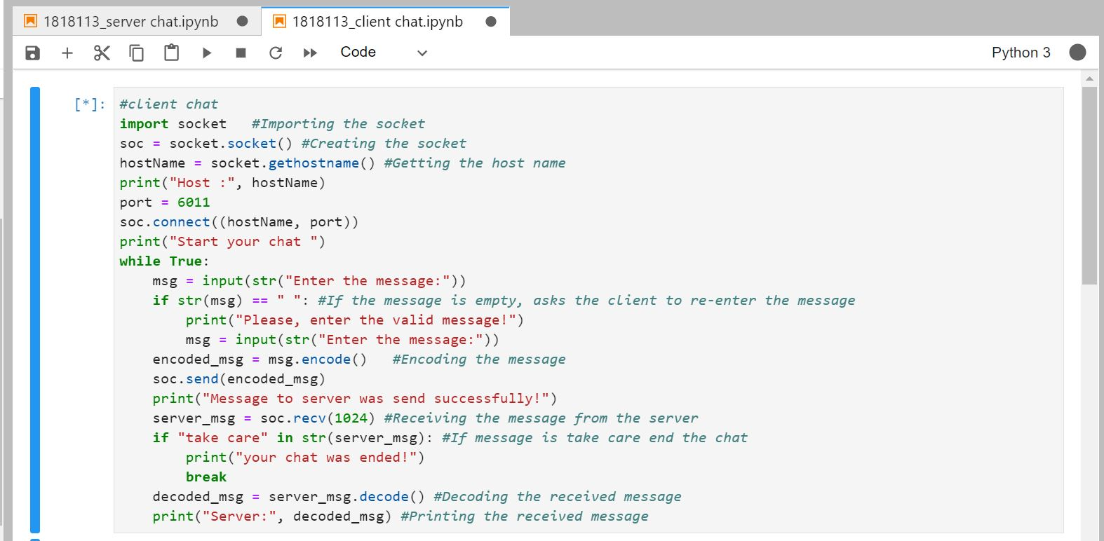

Slide 6
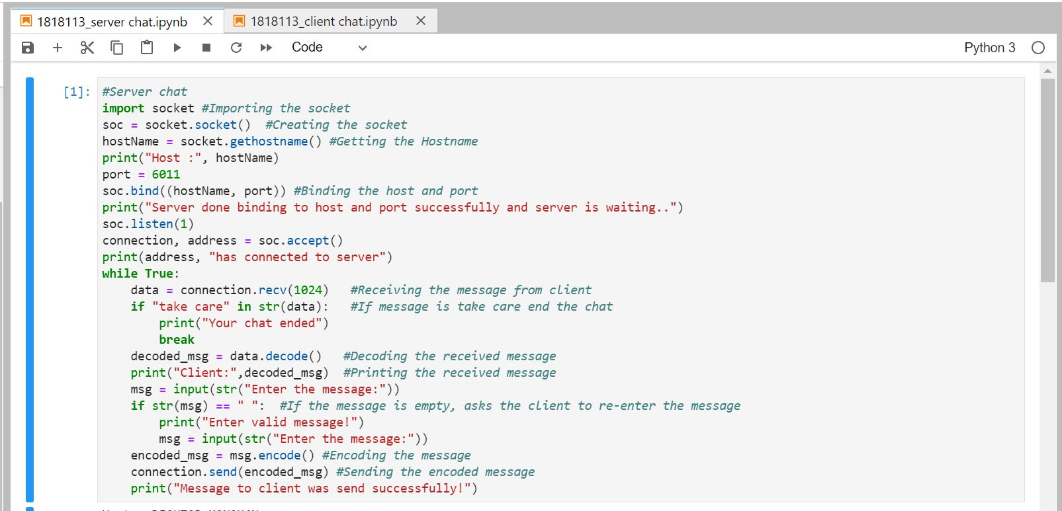

Slide 7
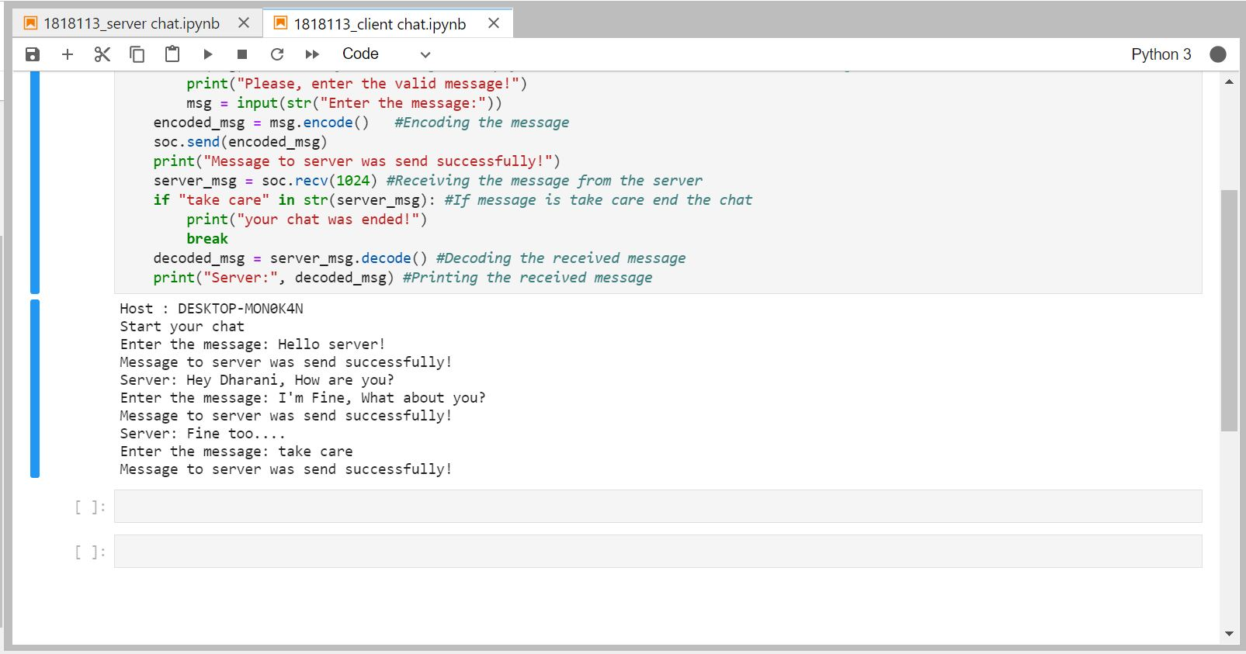

Slide 8
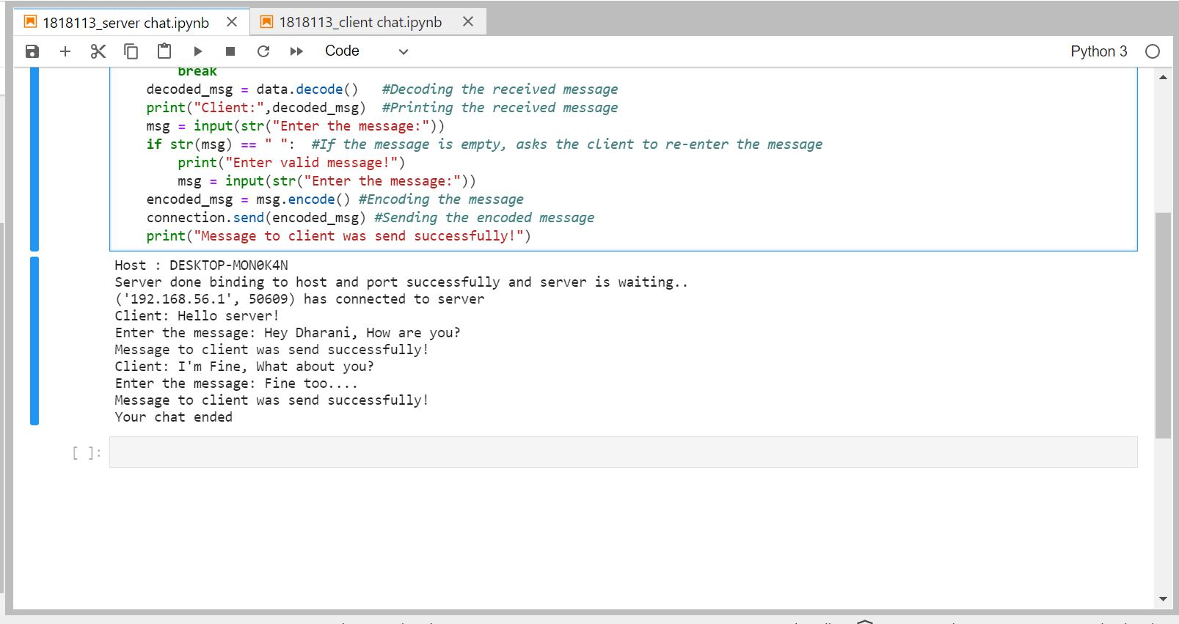

Slide 9
RESULT:
Thus the chat with client and server was implemented successfully.

